Slide 1




Comparative Study of Speech Denoising Techniques
Presented by:
Aanish Nair
Prithwijit Chowdhury
Ningyuan Yang
Sumedh Ravi

Slide 2

Speech Denoising
Process of producing noise-free speech signals from noisy recordings
Involves improving the perceived quality of the speech component and increasing its intelligibility.
Noise can be introduced at different stages:
Background additive noise at the source.
Data conversion
Data transmission
Reproduction

Slide 3
Motivation
Useful in applications where there is a presence of background noise at the source of speech. Ex: Voice calling, video conferencing etc.
Enhancement of recorded speech affected by reverberation.
Improve performance of other tasks such as speech compression, speaker recognition and speaker verification.
To aid hearing-impaired listeners.

Slide 4
Types of Speech Enhancement Algorithms
Spectral Processing
Spectral Subtraction
Minimum Mean Square Estimator
Wiener filtering
Temporal Processing
Linear Prediction Residual Enhancement
Inverse Filtering
Cepstral Filtering

Slide 5
STOI Evaluation Metric
STOI stands for Short Time Objective Intelligibility
STOI is a metric to predict intelligibility of noisy speech
Correlation of short-time temporal envelopes between the clean and denoised speech sample.
Positively correlated to human speech intelligibility.

Slide 6
Spectral Subtraction
Restoration of the power spectrum or magnitude spectrum of a signal observed in additive noise.
Assumption is that noise is a stationary or slow-moving process.
Noise spectrum does not change significantly during update periods.
Noise is additive and locally smooth.
The nonlinear rectification process distorts the distribution of restored signal.
Processing the distortion becomes more noticeable as SNR decreases.

Slide 7
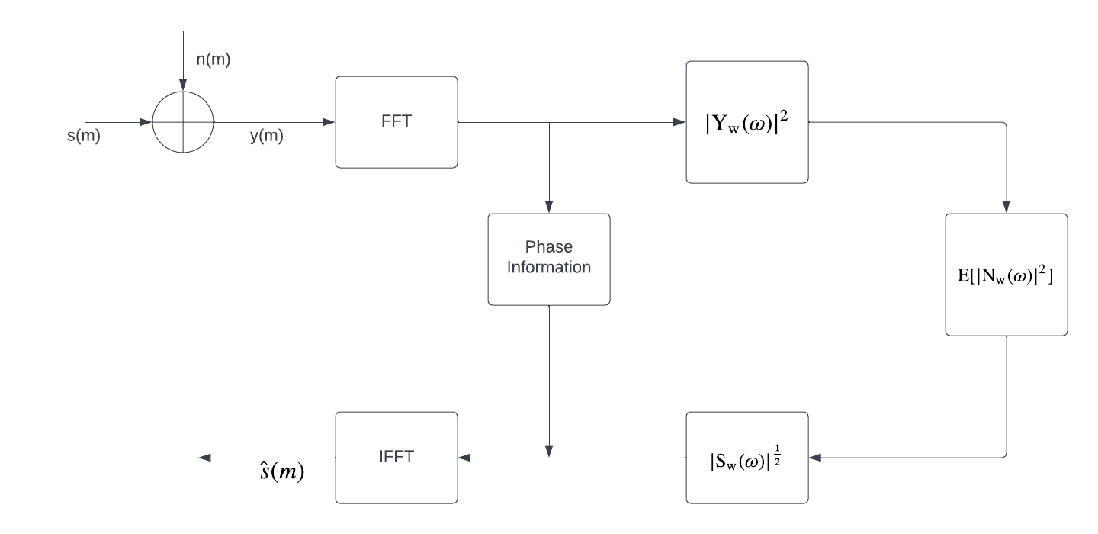
Spectral Subtraction
Block Diagram

Slide 8
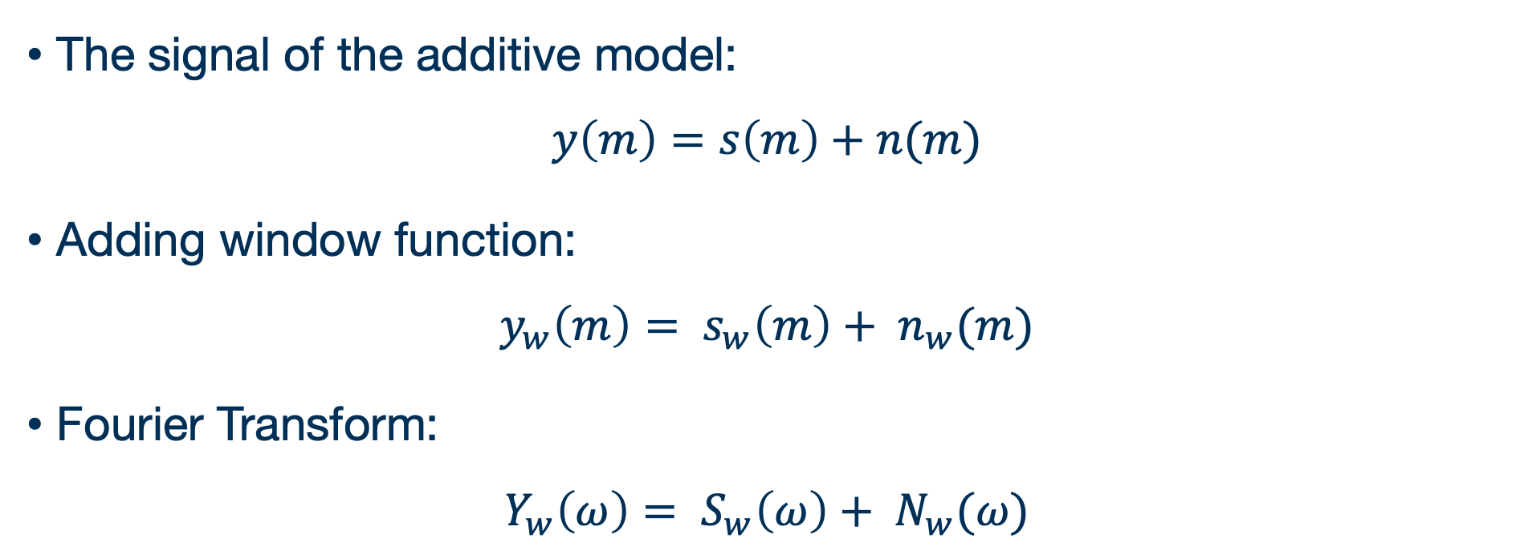
Spectral Subtraction
The signal of the additive model:
$$y\left(m\right)=s\left(m\right)+n(m)$$
Adding window function:
$$y_{w}\left(m\right)= s_{w}\left(m\right)+ n_{w}(m)$$
Fourier Transform:
$$Y_{w}\left(ω\right)= S_{w}\left(ω\right)+ N_{w}(ω)$$

Slide 9
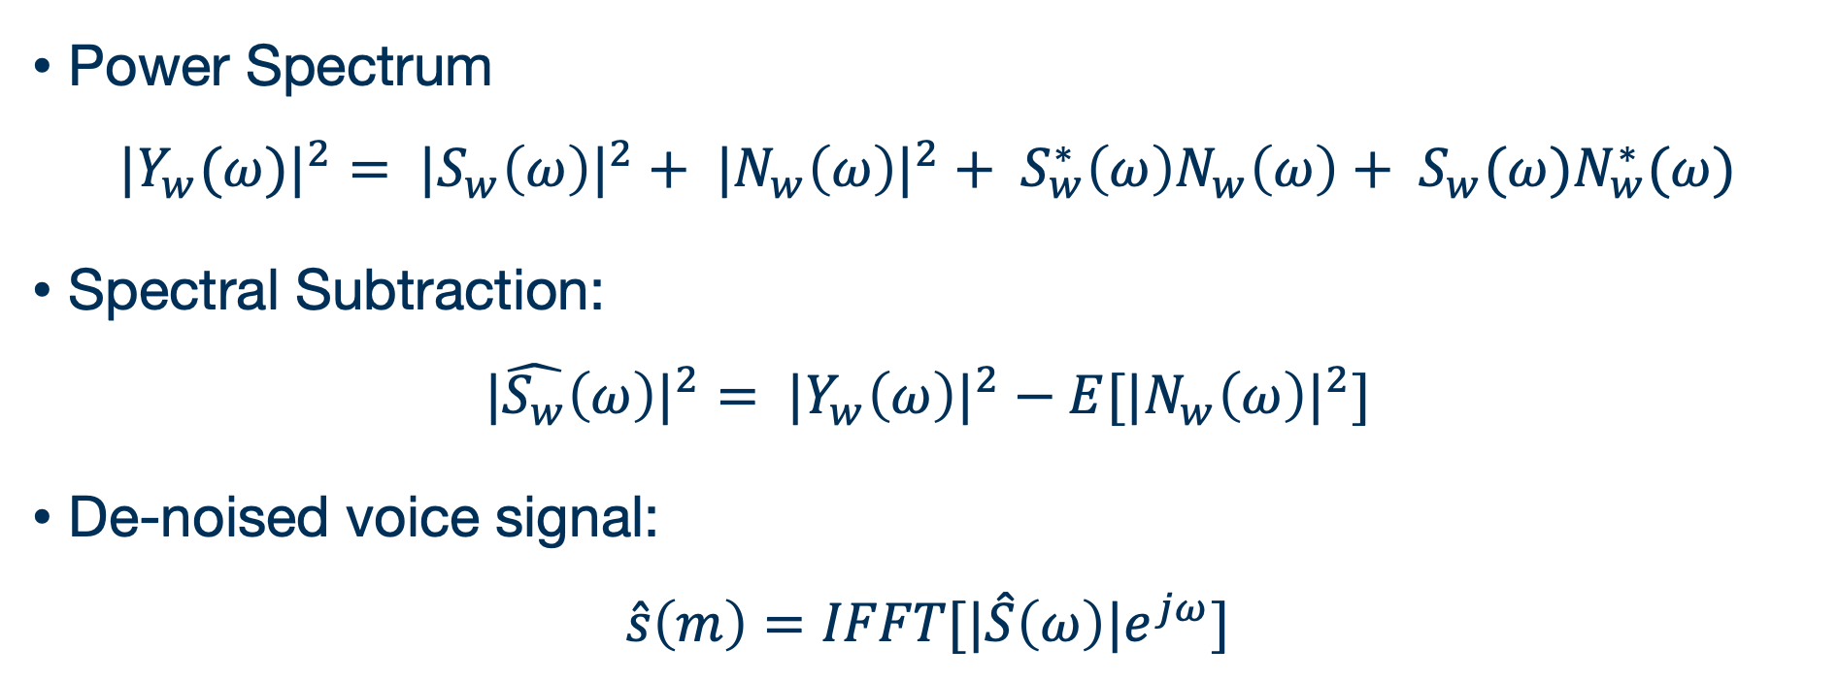
Spectral Subtraction
Power Spectrum
$${{|Y}_{w}(ω)|}^{2}= {{|S}_{w}\left(ω\right)|}^{2}+ {{|N}_{w}\left(ω\right)|}^{2}+ S_{w}^{∗}\left(ω\right)N_{w}\left(ω\right)+ S_{w}(ω)N_{w}^{∗}(ω)$$
Spectral Subtraction:
$${|\hat{S_{w}}\left(ω\right)|}^{2}= {|Y_{w}\left(ω\right)|}^{2}−E[{|N_{w}\left(ω\right)|}^{2}]$$
De-noised voice signal:
$$\hat{s}\left(m\right)=IFFT[|\hat{S}\left(ω\right)|e^{jω}]$$

Slide 10
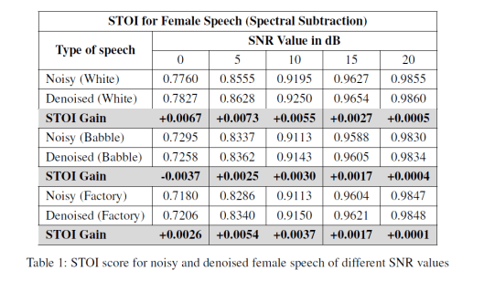
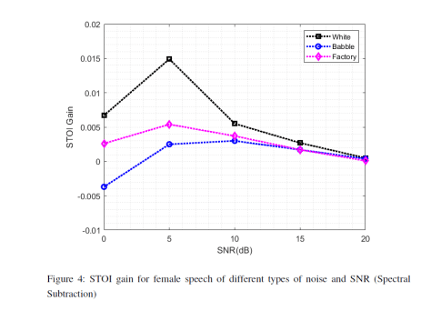
Spectral Subtraction
EXPERIMENTAL RESULTS:

Slide 11
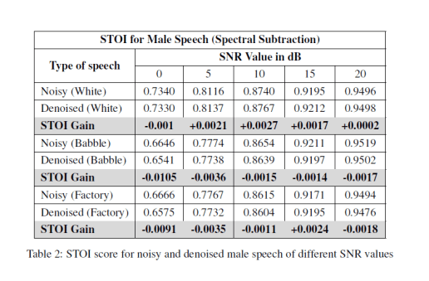
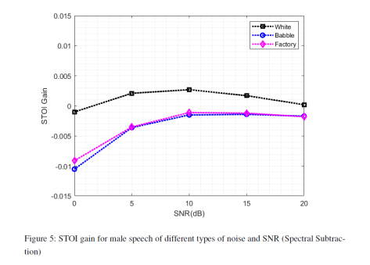
Spectral Subtraction
EXPERIMENTAL RESULTS:
0 GAIN

Slide 12

Spectral Subtraction - Results
Clean Female Speech
Clean Male Speech
Noisy Female Speech – SNR 5dB
Noisy Male Speech – SNR 5dB
Female Reconstructed Speech
Male Reconstructed Speech

Slide 13
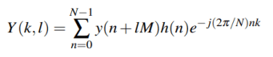
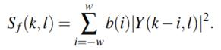
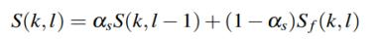
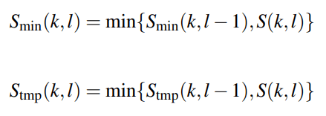
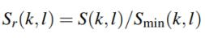
Minima Controlled Recursive Averaging (MCRA)
1. STFT
2. Smooth power spectrum
3. Local minimum of S(k, l)
4. The ratio Sr(k, l)

Slide 14
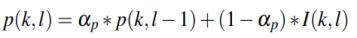
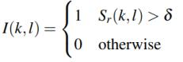
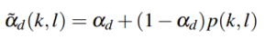
Minima Controlled Recursive Averaging (MCRA)
5. Speech presence probability
6. Smooth parameter
7. Estimated noise spectrum
8. The gain G(k, l)

Slide 15
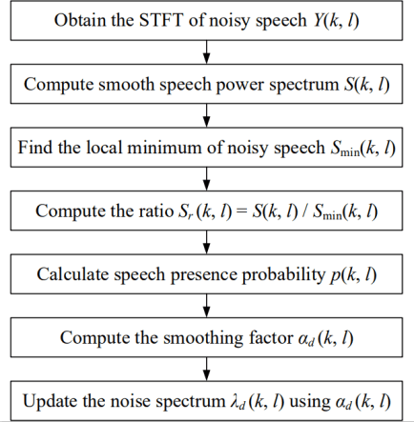
Minima Controlled Recursive Averaging (MCRA)
Flow Diagram:
Code Source:
https://github.com/Gauri-Prajapati/Speech_Enhancement

Slide 16

Minima Controlled Recursive Averaging (MCRA)
Experimental Results:
Clean female speech
Clean male speech
Noisy female speech
with white noise of
SNR = 0 dB
Noisy male speech
with white noise of
SNR = 0 dB
Denoised female speech
Denoised male speech

Slide 17
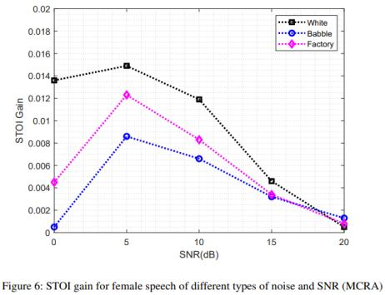
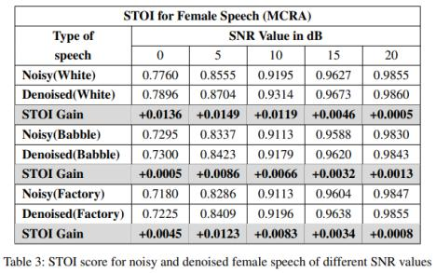
Minima Controlled Recursive Averaging (MCRA)
Experimental Results:

Slide 18
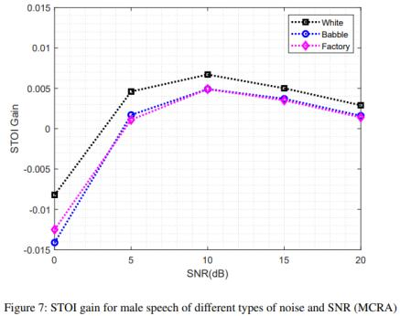
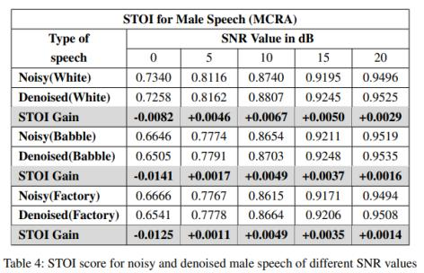
Minima Controlled Recursive Averaging (MCRA)
Experimental Results:

Slide 19
Deep Learning based Noise Suppression (NSNet2)
Deep learning-based noise suppression has the additional benefit of reducing extremely non-stationary noise and background noises
NSNet2 was released as a baseline for the Deep Noise Suppression (DNS) Challenge hosted yearly by Microsoft and is the current STOA for noise suppression and speech enhancement.

Slide 20
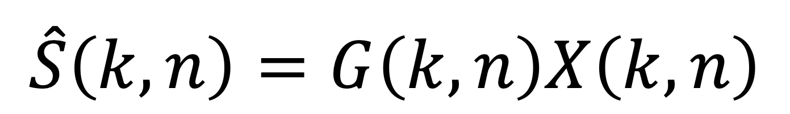
Deep Learning based Noise Suppression (NSNet2)
Principle
The goal is to recover an approximation of the speech signal.
$$\hat{S}\left(k,n\right)=G\left(k,n\right)X\left(k,n\right)$$
Filter
Approximate reconstructed signal

Slide 21
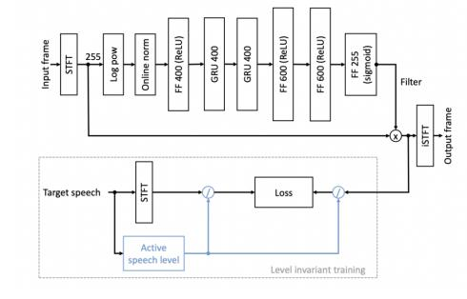
Deep Learning based Noise Suppression (NSNet2)
Principle
FILTER

Slide 22
Deep Learning based Noise Suppression (NSNet2)

Slide 23



Deep Learning based Noise Suppression (NSNet2)
DEMONSTRATION PAGE:
female_white_5.wav
Filtered_fem_wav.wav
CLEAN.wav

Slide 24


Deep Learning based Noise Suppression (NSNet2)
DEMONSTRATION PAGE:
male_white_5.wav
Filtered__male_wav.wav
CLEAN.wav

Slide 25
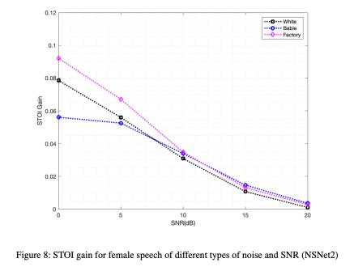
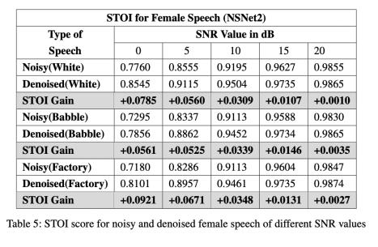
Deep Learning based Noise Suppression (NSNet2)
EXPERIMENTAL RESULTS:

Slide 26
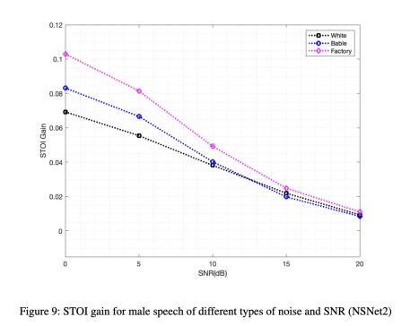
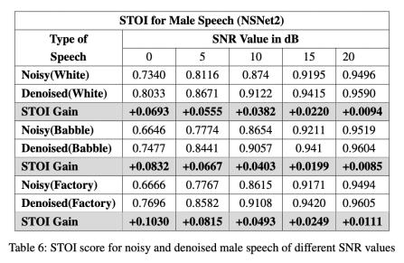
Deep Learning based Noise Suppression (NSNet2)
EXPERIMENTAL RESULTS:
0 GAIN

Slide 27
Comparison between the three methods:
Spectral Subtraction
VS
MCRA
VS
NSNET2

Slide 28
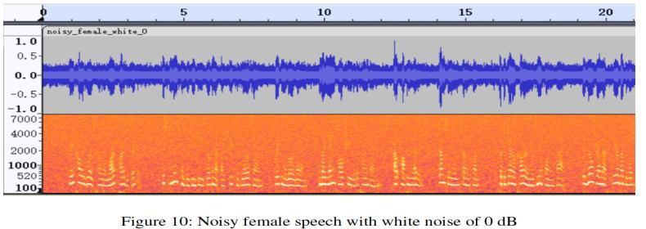
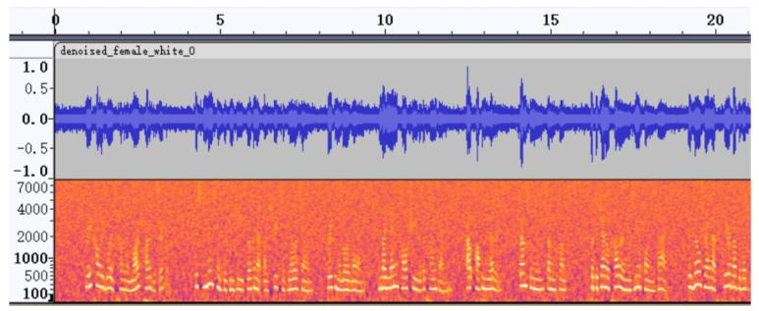
NOISY SIGNAL
USING SPECTRAL SUBTRACTION

Slide 29
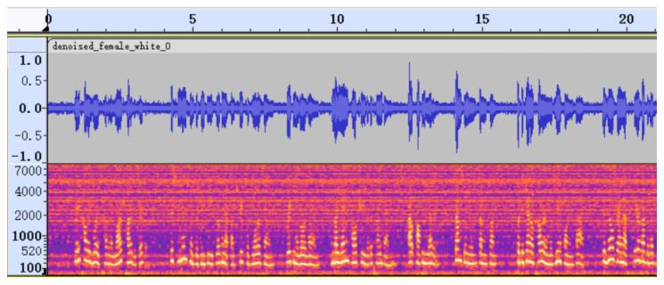
NOISY SIGNAL
USING MCRA

Slide 30
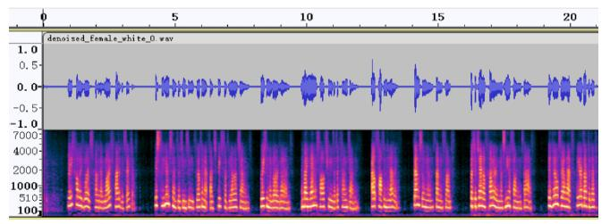
NOISY SIGNAL
USING NSNET2

Slide 31
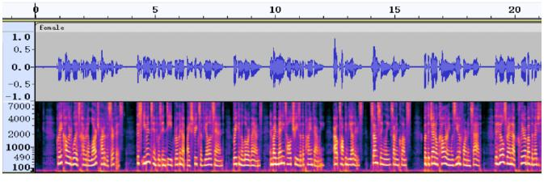
USING NSNET2
CLEAN AUDIO

Slide 32
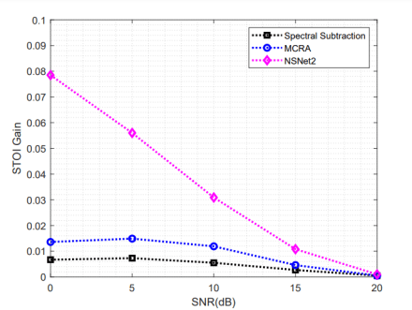
Comparison of STOI gain from all 3 methods

Slide 33
Future work and conclusion
Spectral Subtraction and MCRA are computationally efficient, but the gain is low or even negative for signals with low SNR (0 dB).
Deep learning-based approach provides better improvement in the intelligibility of noisy signals, even for signals with low SNR.
With increasing ease of availability of computing resources and noisy data, deep learning-based solutions are ideal.
The future scope of study is to further improve deep learning methods, experimenting with different model architectures and training methods and also incorporating more training data.

